Slide 1
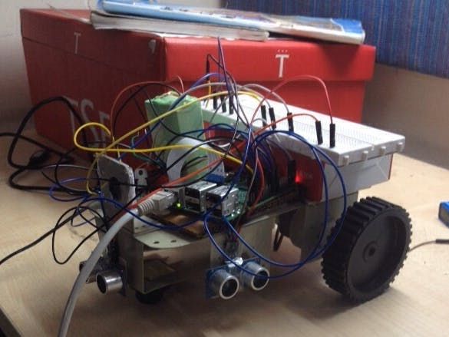
Ball Tracking Robot
An idea for some automated surveillance techniques where a robot will be able to detect stuff and perform high end surveillance.

Slide 2
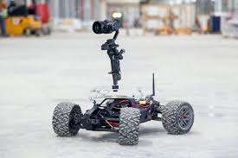
Problem Description
Today's surveillance provides a major drawback which is that it rests on the involvement of humans which as we all know can be easily distracted, so it was to our utmost important to discover a system which can monitor regions autonomously and continuously. And also we want to identify obnoxious or unwanted things and dangers while simultaneously making decisions and respond accordingly. So object tracking with the use of intelligent systems and computers is essential and crucial to achieve automated surveillance

Slide 3
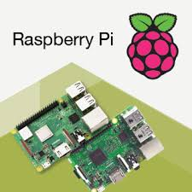
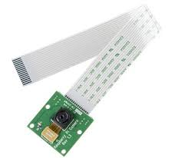
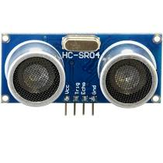
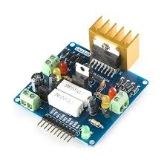
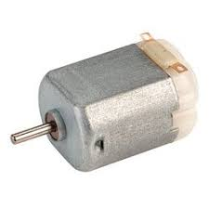
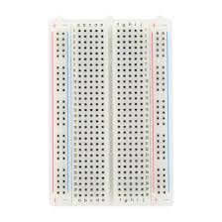
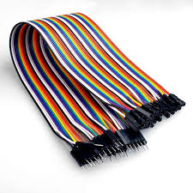
Components Required (Hardware)
Raspberry Pi
Raspberry Pi Camera Module
Ultrasonic Sensor
SparkFun Dual H-Bridge motor drivers L298
DC Motor
Breadboard
Connecting Wires

Slide 4


Software and Hand tools Used
Software Apps Used: OpenCV
Hand Tools: Python

Slide 5
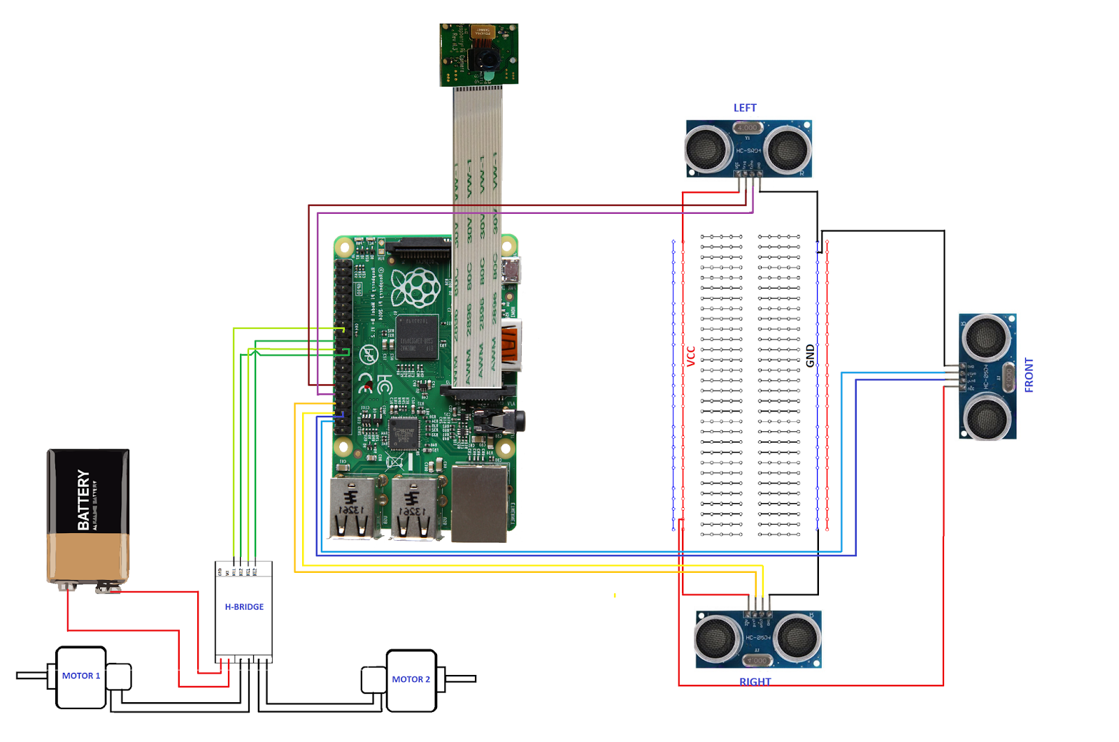
Schematics (Circuit Diagram)
First of all the raspberry Pi Camera module is directly connected to the raspberry Pi.
The Ultra sonic sensors VCC are connected to the common terminal same is with the GND (ground) and the remaining two ports of ultrasonic sensor is connected to the GPIO pins on the raspberry Pi.
The Motors are connected using the H-Bridge.
The Power is supplied using the Battery.

Slide 6


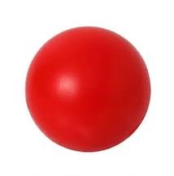

About the Project
I made this project depicting a basic robot which can track a ball. Robot uses camera to do image processing by taking frames and track the ball. To track the ball various features like its colour, size, shape are used.
The Robot finds a hard coded colour and then search for the ball of that colour and follows it.
I have chosen Raspberry Pi as micro-controller in this project because it allows us to use its camera module and gives great flexibility in code as it uses python language which is very user friendly and also it lets us use OpenCV library for analysing the images.
An H-Bridge has been used to switch the direction of rotation of motors or to stop them

Slide 7
Thank You…

